Slide 1
ARM and Automate Yourself for Speedy Application Deployments
Dennis Moon – MadDotNet, July 11th, 2018

Slide 2

Married to Christine
Son Ian and future daughter-in-law Kaila
Hobbies: Guitar, Singing, Travel
Passions: Learning, Technology, Music
Employer: CUNA MUTUAL Financial Group
Senior software engineer, designer and architect. Currently learning cloud architecture.

Slide 3
Contents
Application Infrastructure
Azure Resource Manager
ARM Templates
Azure Automation
Runbooks
VSTS Release Pipeline

Slide 4
Application Infrastructure
The infrastructure for your application is typically made up of many components:
Virtual Machine
Storage Account
Virtual Network
Web App
Database Server (with database)
Load Balancers
Firewall
Third-party Services
Etc.

Slide 5
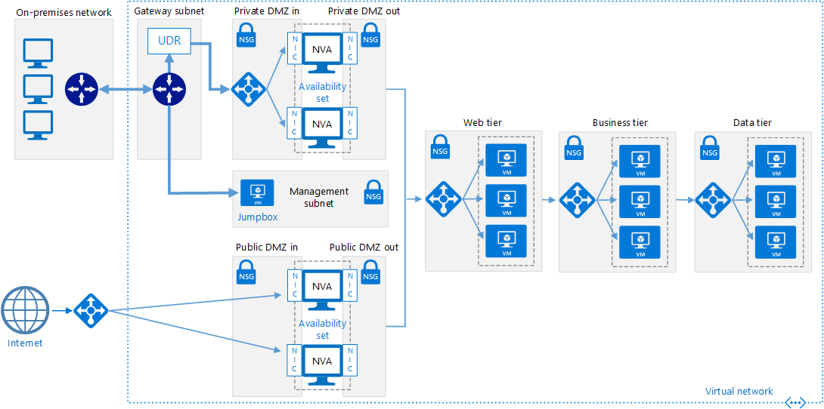

Slide 6
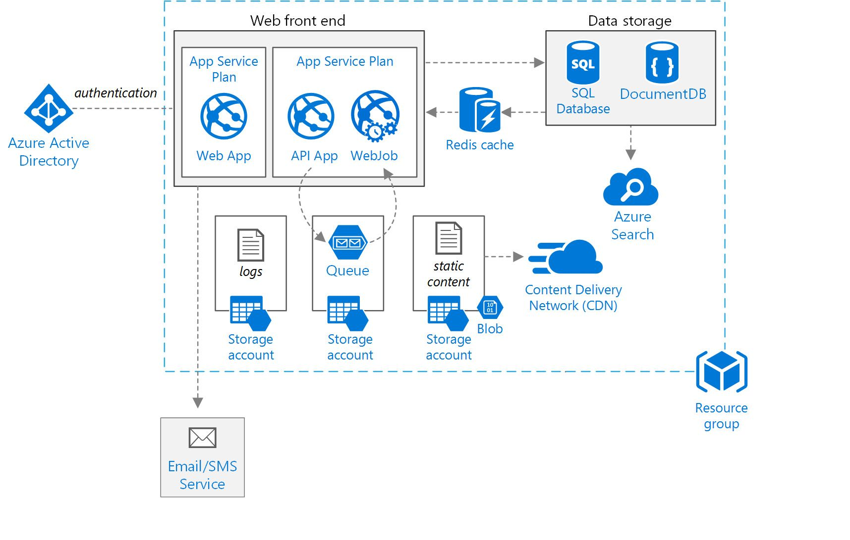

Slide 7
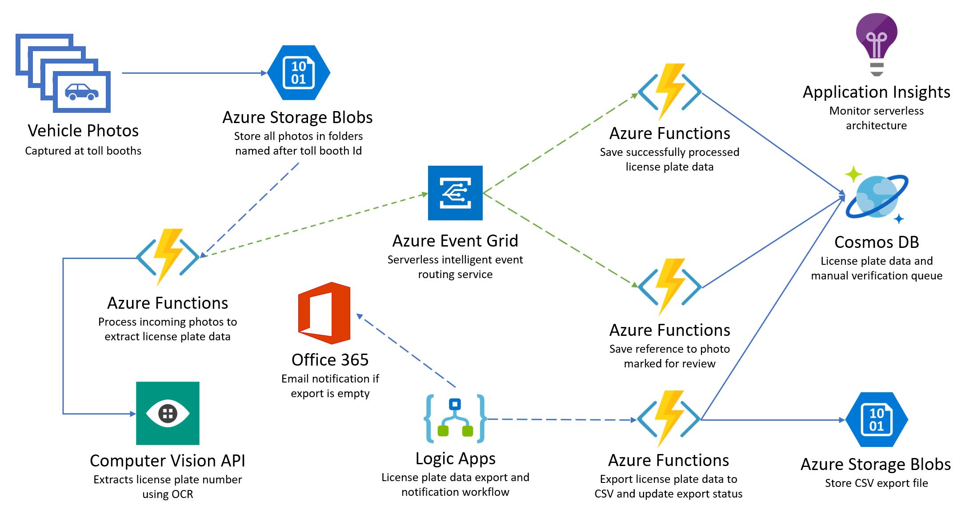

Slide 8
Azure Resource Manager
You want to deploy, manage, and monitor your system resources as a group.
Azure Resource Manager enables you to work with the resources in your solution as a group.
You can deploy, update, or delete all the resources for your solution in a single, coordinated operation.
You use a template for deployment and that template can work for different environments such as testing, staging, and production.
Resource Manager provides security, auditing, and tagging features to help you manage your resources after deployment.

Slide 9
Consistent Management Layer
Resource Manager provides a consistent management layer to perform tasks through:
Azure Portal
Azure PowerShell
Azure CLI
Azure Management REST API
Azure Management Fluent Client SDKs
All capabilities that are available in the Azure portal are also available through Azure PowerShell, Azure CLI, the Azure Management REST APIs, and Azure Fluent Client SDKs.
Functionality initially released through APIs will be represented in the portal within 180 days of initial release. (think preview services and features)
Choose the tools and APIs that work best for you - they have the same capability and provide consistent results.

Slide 10
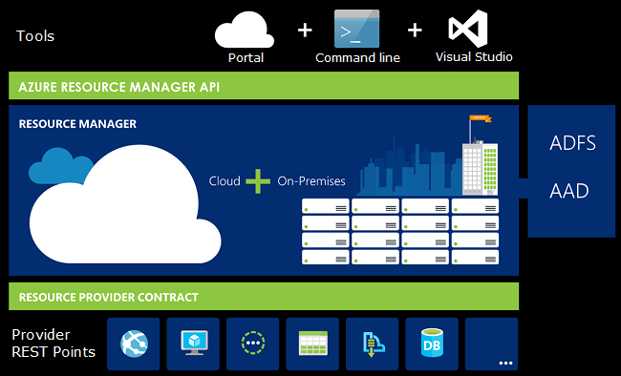

Slide 11
Terminology
Resource - A manageable item that is available through Azure. Some common resources are a virtual machine, storage account, web app, database, and virtual network, but there are many more.
Resource Group - A container that holds related resources for an Azure solution. The resource group can include all the resources for the solution, or only those resources that you want to manage as a group. You decide how you want to allocate resources to resource groups based on what makes the most sense for your organization.
Resource Provider - A service that supplies the resources you can deploy and manage through Resource Manager. Each resource provider offers operations for working with the resources that are deployed. Some common resource providers are Microsoft.Compute, which supplies the virtual machine resource, Microsoft.Storage, which supplies the storage account resource, and Microsoft.Web, which supplies resources related to web apps.

Slide 12
Terminology - continued
Azure Resource Manager (ARM) template - A JavaScript Object Notation (JSON) file that defines one or more resources to deploy to a resource group. It also defines the dependencies between the deployed resources. The template can be used to deploy the resources consistently and repeatedly.
Declarative Syntax - Syntax that lets you state "Here is what I intend to create" without having to write the sequence of programming commands to create it. The Resource Manager template is an example of declarative syntax. In the file, you define the properties for the infrastructure to deploy to Azure.

Slide 13
Benefits of Using Resource Manager
You can deploy, manage, and monitor all the resources for your solution as a group, rather than handling these resources individually.
You can repeatedly deploy your solution throughout the development lifecycle and have confidence your resources are deployed in a consistent state.
You can manage your infrastructure through declarative templates rather than scripts.
You can define the dependencies between resources so they're deployed in the correct order.
You can apply access control to all services in your resource group because Role-Based Access Control (RBAC) is natively integrated into the management platform.
You can apply tags to resources to logically organize all the resources in your subscription.
You can clarify your organization's billing by viewing costs for a group of resources sharing the same tag.

Slide 14
Guidance
The following suggestions help you take full advantage of Resource Manager when working with your solutions.
Define and deploy your infrastructure through the declarative syntax in Resource Manager templates, rather than through imperative commands.
Define all deployment and configuration steps in the template. You should have no manual steps for setting up your solution.
Run imperative commands to manage your resources, such as to start or stop an app or machine.
Arrange resources with the same lifecycle in a resource group. Use tags for all other organizing of resources.

Slide 15
Resource Groups
There are some important factors to consider when defining your resource group:
All the resources in your group should share the same lifecycle. You deploy, update, and delete them together. If one resource, such as a database server, needs to exist on a different deployment cycle it should be in another resource group.
Each resource can only exist in one resource group.
You can add or remove a resource to a resource group at any time.
You can move a resource from one resource group to another group.
A resource group can contain resources that reside in different regions.
A resource group can be used to scope access control for administrative actions.
A resource can interact with resources in other resource groups. This interaction is common when the two resources are related but don't share the same lifecycle (for example, web apps connecting to a database).

Slide 16
ARM Template Format
{
"$schema": "http://schema.management.azure.com/schemas/2015-01-01/deploymentTemplate.json#",
"contentVersion": "",
"parameters": { },
"variables": { },
"functions": { },
"resources": [ ],
"outputs": { }
}

Slide 17
ARM Template Elements
Element name | Required | Description
$schema | Yes | Location of the JSON schema file that describes the version of the template language.
contentVersion | Yes | Version of the template (such as 1.0.0.0). You can provide any value for this element. Use this value to document significant changes in your template. When deploying resources using the template, this value can be used to make sure that the right template is being used.
parameters | No | Values that are provided when deployment is executed to customize resource deployment.
variables | No | Values that are used as JSON fragments in the template to simplify template language expressions.
functions | No | User-defined functions that are available within the template.
resources | Yes | Resource types that are deployed or updated in a resource group.

Slide 18
Demos
Create a New Resource Manager Project
Define a Storage Account Template
Check Code into Git
Create a VSTS Release Pipeline
Deploy Template
Deploy Infrastructure to Azure Resource Group
Deploy Multiple ARM Template Resources
Deploy a Nested ARM Template

Slide 19
Automation Accounts
Azure Automation delivers a cloud-based automation and configuration service that provides consistent management across your Azure and non-Azure environments.
It consists of process automation, update management, and configuration features.
Azure Automation provides complete control during deployment, operations, and decommissioning of workloads and resources.

Slide 20
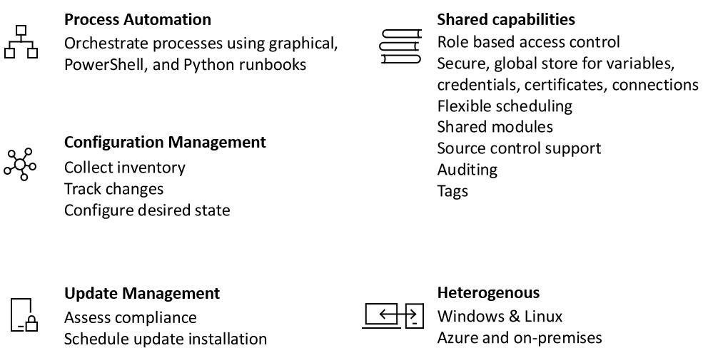

Slide 21
Process Automation
Azure Automation provides you the ability to automate frequent, time-consuming, and error-prone cloud management tasks.
This automation helps you focus on work that adds business value. By reducing errors and boosting efficiency, it also helps to lower your operational costs.
You can integrate Azure services and other public systems that are required in deploying, configuring, and managing your end to end processes.
The service allows you to author runbooks graphically, in PowerShell, or Python.
By using a hybrid Runbook worker, you can unify management by orchestrating across on-premises environments.
Webhooks provide a way to fulfill requests and ensure continuous delivery and operations by triggering automation from ITSM, DevOps, and monitoring systems.

Slide 22
Configuration Management
Azure Automation desired state configuration is a cloud-based solution for PowerShell DSC that provides services required for enterprise environments.
Manage your DSC resources in Azure Automation and apply configurations to virtual or physical machines from a DSC Pull Server in the Azure cloud.
It provides rich reports that inform you of important events such as when nodes have deviated from their assigned configuration.
You can monitor and automatically update machine configuration across physical and virtual machines, Windows or Linux, in the cloud or on-premises.

Slide 23
Shared Capabilities
Azure Automation consists of a set of shared resources that make it easier to automate and configure your environments at scale.
Role-based access control - Control access to the account with an Automation operator role that enables tasks to be run without giving authoring capabilities.
Variables - Provide a way to hold content that can be used across runbooks and configurations. You can change values without having to modify any of the runbooks and configurations that reference them.
Credentials - Securely store sensitive information that can be used by runbooks and configurations at runtime.
Certificates - Store and make available at runtime so they can be used for authentication and securing deployed resources.

Slide 24
Shared Capabilities - continued
Connections - Store a name / value pairs of information that contains common information when connecting to systems in connection resources. Connections are defined by the module author for use at runtime in runbooks and configurations.
Schedules - Used in the service to trigger automation on predefined times.
Integration with source control - Promotes configuration as code where runbooks or configurations can be checked into a source control system.
PowerShell modules - Modules are used to manage Azure and other systems. Import into the Automation account for Microsoft, third party, community, or custom defined cmdlets and DSC resources.

Slide 25
Common Scenarios for Automation
Azure Automation manages across the lifecycle of your infrastructure and applications. Transfer knowledge into the system on how the organization delivers and maintains workloads. Author in common languages like PowerShell, desired state configuration, Python, and graphical runbooks. Get a complete inventory of deployed resources for targeting, reporting, and compliance. Identify changes that can cause misconfiguration and improve operational compliance.
Build / Deploy resources - Deploy VMs across a hybrid environment using Runbooks and Azure Resource Manager templates. Integrate into development tools like Jenkins and Visual Studio Team services.
Configure VMs - Assess and configure Windows and Linux machines with the desired configuration for the infrastructure and application.
Monitor - Identify changes on machines that are causing issues and remediate or escalate to management systems.
Protect - Quarantine VM if security alert is raised. Set in-guest requirements.
Govern - Set up role-based access control for teams. Recover unused resources.

Slide 26
Demos
Create an Azure Automation Account
https://docs.microsoft.com/en-us/azure/automation/automation-quickstart-create-account
Create a Runbook
https://docs.microsoft.com/en-us/azure/automation/automation-quickstart-create-runbook

Slide 27
Pluralsight Links
Azure Resource Manager Videos on Pluralsight
https://dennismoon.com/links/azure-resource-manager-videos-on-pluralsight/
Azure Automation Videos on Pluralsight
https://dennismoon.com/links/azure-automation-videos-on-pluralsight/
PowerShell Videos on Pluralsight
https://dennismoon.com/links/powershell-videos-on-pluralsight/
Azure .NET Developer Videos on Pluralsight
https://dennismoon.com/links/azure-net-developer-videos-on-pluralsight/

Slide 28
Resource Links
Create and deploy your first Azure Resource Manager template
https://docs.microsoft.com/en-us/azure/azure-resource-manager/resource-manager-create-first-template
ARM Template Resources
https://dennismoon.com/links/arm-template-resources/
Visual Studio Code Extensions
https://dennismoon.com/links/visual-studio-code-extensions/
Azure Resource Manager QuickStart Templates
https://github.com/Azure/azure-quickstart-templates

Slide 29
My Info
Blog: https://dennismoon.com
Code Repository: https://github.com/comfycoder
Twitter: @comfycoder
Linked in:
https://www.linkedin.com/in/dennis-moon-b469b93
OneNote (Take Your Angular App Glamping): https://1drv.ms/u/s!ArCsAhaG3htJogmm7yGnOk-gCNTZ

Slide 30
Questions?

